Slide 1
Furssan Fight Club
Presented by Furqan Khan and Hassan Fardous
03/05/2024

Slide 2



What and Why
THE IDEA: BOOKING SYSTEM FOR MARTIAL ARTS CLASSES
PURPOSE: To give users the option to book fighting classes, with options of different fighting arts, times, payment methods, etc
A fighting gym's data offers insights on fitness and martial arts enthusiasts, making it attractive for targeted sports and health product ads. Advertisers can use this data to precisely reach individuals interested in their products.

Slide 3
How (describe 2+ functional requirement in user the story telling way)
New member signs up online, filling out a form to become a gym member.
Member searches for classes based on one or more of the following: reviews, instructor(s), studio(s), martial arts type
Member views the full gym schedule to pick a convenient training time.
Member books a personal training session and pays online to confirm their spot. If the class is full, the system shows that the class is full.
If the Member cancels a booking, the slot reopens for others, and the member gets a cancellation confirmation.

Slide 4
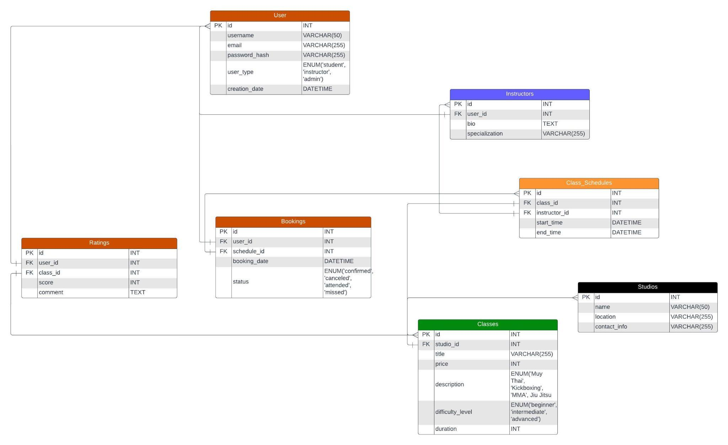

Slide 5
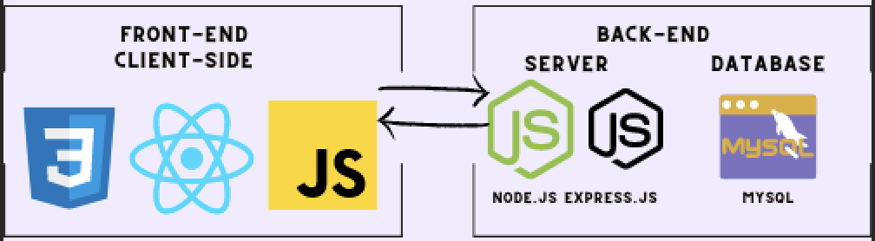
The Stack

Slide 6
Member Roles
FURQAN KHAN
HASSAN FARDOUS
Front-end:
React, JS, CSS
Backend Database: MySQL
Server-side Backend:
Node.js and Express.js
Database: MySQL

Slide 7
Q&A

